Slide 1
MM2DYN Dynamics: Control Lecture 3
Block Diagram Representation of control systems and their manipulation
Block Diagram treatment for hydraulic position control

Slide 2
Lecture Objectives:
Demonstrate Block diagram manipulation
Demonstrate System modelling for a first order system
MMME2046 Dynamics and Control
Lecture 3

Slide 3
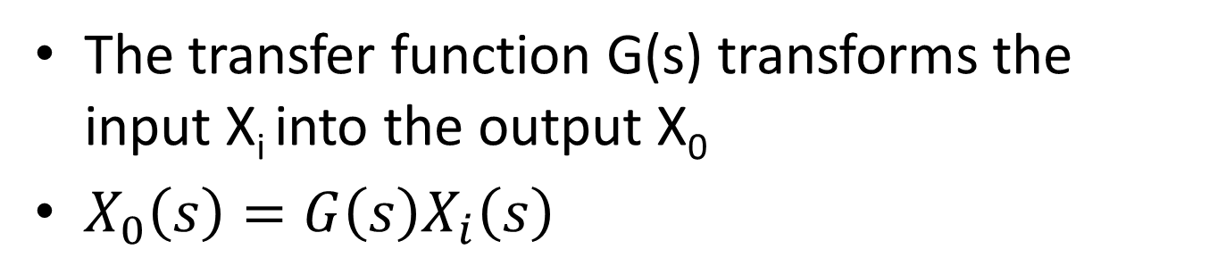
Block Diagrams Revisited
Systems engineers represent the components of the system as a series of blocks:
Recap:
X_{i}(s)
X_{o}(s)
G(s)
The transfer function G(s) transforms the input X_{i} into the output X₀
$X_{0}\left(s\right)=G\left(s\right)X_{i}\left(s\right)$
MMME2046 Dynamics and Control
Lecture 3

Slide 4
Block Diagram Manipulation: The rules
a) Elements in Series
G₁X_{i}
G₂G₁X_{i}
X_{i}(s)
G₁(s)
G₂(s)
X_{o}(s)
X_{i}(s)
G₂G₁
X_{o}(s)
b) Elements in Parallel
G₁X_{i}
G₁(s)
+
+
X_{o}(s)
X_{i}(s)
X_{o}(s)
X_{i}(s)
G₂(s)
G₁+G₂ - G₃
_
G₃(s)
G₂X_{i}
G₃X_{i}
MMME2046 Dynamics and Control
Lecture 3

Slide 5
c) Feedback (Closed loop) Transfer Function
X_{i} – HX_{o}
G(X_{i} – HX_{o})
X_{i}
+
X_{o}
X_{i}
X_{o}
G(s)
_
H(s)
HX_{o}
d) Changing block positions:
X_{i} – HX_{o}
X_{i} – HX_{o}
X_{i}
X_{o}
X_{i}
+
X_{o}
+
G
H
G
1/H
_
_
H
X
Z
X
+
Z
+
G
G
_
_
Y
Y
G
MMME2046 Dynamics and Control
Lecture 3

Slide 6

d) Changing block positions
X
Z
X
+
Z
+
G
G
_
_
Y
Y
G
$$Z\left(s\right)=G\left(s\right)\left(X\left(s\right)−Y\left(s\right)\right)$$
Check: Does this give the same result?
MMME2046 Dynamics and Control
Lecture 3

Slide 7


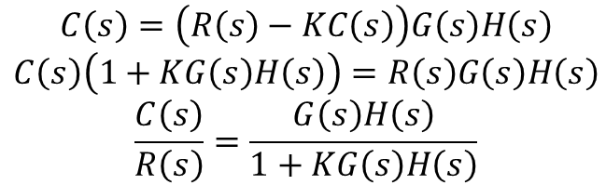














e) Dealing with disturbances
R(s) is the input
C(s) is the output
D(s) is a disturbance
N(s) is a (user controlled) compensation
$$D\left(s\right)$$
$$R\left(s\right)$$
$$+$$
$$G\left(s\right)$$
$$−$$
$$H\left(s\right)$$
$$C\left(s\right)$$
$$+$$
$$−$$
$$+$$
$$K$$
$$−$$
$$N\left(s\right)$$
Procedure:
  Each of the inputs has its own independent transfer function. For R(s):
$$R\left(s\right)$$
$$+$$
$$G\left(s\right)$$
$$H\left(s\right)$$
$$C\left(s\right)$$
$$C\left(s\right)=\left(R\left(s\right)−KC\left(s\right)\right)G\left(s\right)H\left(s\right)$$
$$C\left(s\right)\left(1+KG\left(s\right)H\left(s\right)\right)=R\left(s\right)G\left(s\right)H\left(s\right)$$
$$\frac{C\left(s\right)}{R\left(s\right)}=\frac{G\left(s\right)H\left(s\right)}{1+KG\left(s\right)H\left(s\right)}$$
$$−$$
$$K$$
MMME2046 Dynamics and Control
Lecture 3

Slide 8
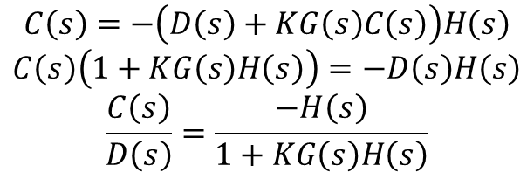




e) Dealing with disturbances
R(s) is the input
C(s) is the output
D(s) is a disturbance
N(s) is a (user controlled) compensation
$$D\left(s\right)$$
$$R\left(s\right)$$
$$+$$
$$G\left(s\right)$$
$$−$$
$$H\left(s\right)$$
$$C\left(s\right)$$
$$+$$
$$−$$
$$+$$
$$K$$
$$−$$
$$N\left(s\right)$$
Procedure:
  For D(s):
$$D\left(s\right)$$
$$−$$
$$H\left(s\right)$$
$$C\left(s\right)$$
$$C\left(s\right)=−\left(D\left(s\right)+KG\left(s\right)C\left(s\right)\right)H\left(s\right)$$
$$C\left(s\right)\left(1+KG\left(s\right)H\left(s\right)\right)=−D\left(s\right)H\left(s\right)$$
$$\frac{C\left(s\right)}{D\left(s\right)}=\frac{−H\left(s\right)}{1+KG\left(s\right)H\left(s\right)}$$
$$−$$
$$KG\left(s\right)$$
MMME2046 Dynamics and Control
Lecture 3

Slide 9
Example: Reduce the block diagram and find the overall T.F.
X_{i}
+
+
X_{o}
G₁
G₂
G₃
_
_
H₁
H₂
i) Rearrange to avoid interlinking loops
X_{i}
+
+
X_{o}
G₁
G₂
G₃
_
_
H₂
H₁ / G₃
MMME2046 Dynamics and Control
Lecture 3

Slide 10



ii) Eliminate the inner loop
X_{i}
+
X_{o}
G₁
_
H₁ / G₃
iii) Reduce to a single block and simplify
X_{i}
X_{o}
X_{i}
X_{o}

Slide 11
MM2DYN Dynamics: Control Lecture 5
Position Control Systems
(case studies in 1st & 2nd order systems)

Slide 12
Lecture Objectives:
Introduce the differences between 1st and 2nd order systems
Analyse steady-state responses under step and ramp inputs
Analyse transient behaviour through the roots of the characteristic equations
MMME2046 Dynamics and Control
Lecture 3

Slide 13
Video Interlude
Motherboard Assembly
  https://www.youtube.com/watch?v=ym64NFCWORY
Before we watch the video:
  Is the robot quicker than the employee?
  Was this robot customised for the application?
  What would happen if the robot overshoots?
MMME2046 Dynamics and Control
Lecture 3

Slide 14

Recap: Hydraulic Position Control System
drain
fluid in
drain
x_{i}
a
y
spool valve
b
q
cylinder
load
x_{o}
piston
area, A
It was shown that the transfer function is given by
1st order system
with the block diagram (to be shown in this lecture)
X_{i}
+
X_{o}
μ
1/Ts
_
MMME2046 Dynamics and Control
Lecture 3

Slide 15













Feedback link:
$$x_{i1}$$
$$x_{i1}$$
$$x_{i1}+x_{i2}$$
$$a$$
$$x_{o}$$
$$x_{o}$$
$$x_{o}+x_{i2}$$
$$b$$
$$θ$$
$$x_{i2}$$
$$x_{i2}$$
$$x_{i2}$$

Slide 16





Hydraulic Position Control System: Equations for the Model
Spool Valve
in the time domain
transfer function
(1)
Ram Piston
in the time domain
transfer function
(2)
Feedback Link
in the time domain
transfer function
(3)
MMME2046 Dynamics and Control
Lecture 3

Slide 17



Hydraulic Position Control System: Overall Transfer Function
X_{i}
spool valve and piston
X_{o}
+
b/(a+b)
K/As
_
a/(a+b)
feedback link
From the block diagram
rearranging
(4)
First order system with time constant T and gain μ
MMME2046 Dynamics and Control
Lecture 3

Slide 18


Hydraulic Position Control System: Control System Model
X_{i}
X_{o}
time constant
steady-state gain
Exercise: Show that the block diagram for a system governed by (4) can be drawn as
X_{i}
+
X_{o}
μ
1/Ts
_
MMME2046 Dynamics and Control
Lecture 3

Slide 19
Exercise
From Equation 4:
First of all: recognise that gain is μ:
X_{i}
X_{o}
μ
1/(1+Ts)
MMME2046 Dynamics and Control
Lecture 3

Slide 20

Exercise
From Equation 4:
Second: Unity feedback loop
X_{i}
X_{o}
X_{i}
$$\frac{G\left(s\right)}{1+G\left(s\right)}$$
X_{o}
G(s)
≡
MMME2046 Dynamics and Control
Lecture 3

Slide 21

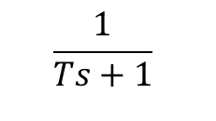

Exercise
From Equation 4:
Third: $G\left(s\right)=\frac{1}{Ts}$
X_{i}
$$\frac{1/{Ts}}{1+1/{Ts}}$$
X_{o}
X_{i}
X_{o}
$$\frac{1}{Ts+1}$$
MMME2046 Dynamics and Control
Lecture 3

Slide 22
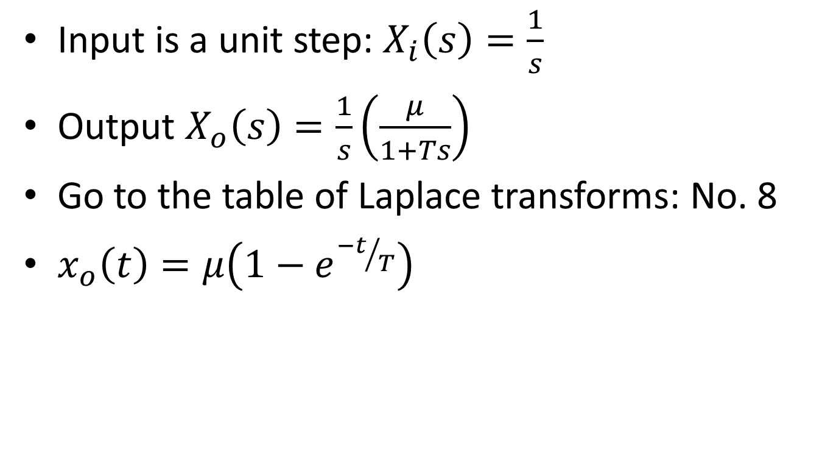
Time domain
Input is a unit step: $X_{i}\left(s\right)=\frac{1}{s}$
Output $X_{o}\left(s\right)=\frac{1}{s}\left(\frac{μ}{1+Ts}\right)$
Go to the table of Laplace transforms: No. 8
$x_{o}\left(t\right)=μ\left(1−e^{{−t}/T}\right)$
MMME2046 Dynamics and Control
Lecture 3

Slide 23


Hydraulic Position Control System under Standard Inputs
i) step Input
t < 0
t ≥ 0
From the table of L.T.
(5)
The output in s-domain
(6)
In the time domain
(7)
speed of rise depends upon T
steady- state error
t
MMME2046 Dynamics and Control
Lecture 3

Slide 24
MMME2046 Dynamics and Control
Lecture 3

Slide 25
Hydraulic Position Control System under Standard Inputs
We will return to this model in a later lecture to go through:
  Using the Final Value Theorem to calculate the steady state response and steady state error
  Examining the system’s response to a ramp input

Slide 26
2nd Order Control Systems
1st order systems are
  Reliable
  Non-oscillatory
  Slower than 2nd order
Hydraulics are slow and heavy
How do they do this?
  https://www.youtube.com/watch?v=U4y1grtRLDs

Slide 27
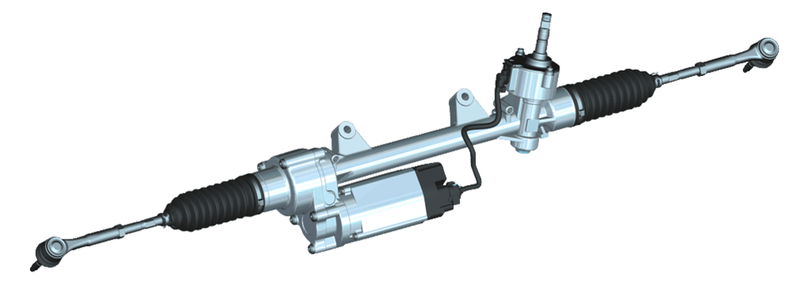
2nd Order Control Systems
Some examples – electro-mechanical position control
  Power steering
  n-degree of freedom robots
  …
Image courtesy of Bosch AG

Slide 28
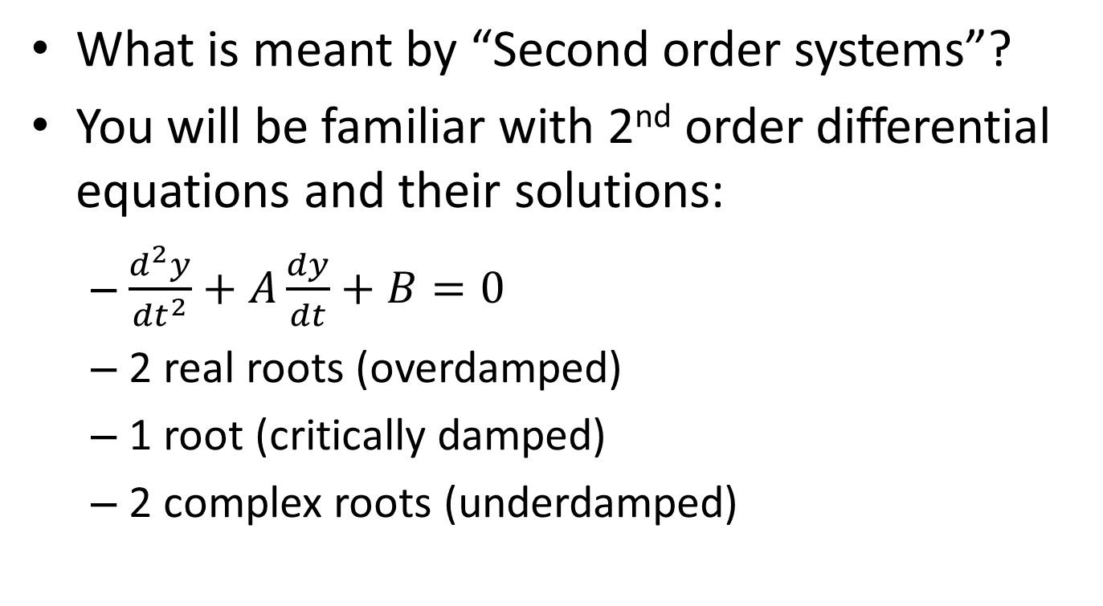
2nd Order Control Systems
What is meant by “Second order systems”?
You will be familiar with 2nd order differential equations and their solutions:
  $\frac{d^{2}y}{{dt}^{2}}+A\frac{dy}{dt}+B=0$
  2 real roots (overdamped)
  1 root (critically damped)
  2 complex roots (underdamped)
MMME2046 Dynamics and Control
Lecture 3

Slide 29

Example: Electro-Mechanical Position Control System
viscous
damping
lead
screw
mass
DC servo-
motor
f_{R}
servo-
amp
x (output)
+
position
transducer
V_{i}
-
input
voltage
It will be shown that the transfer function may be written as
2nd order system
MMME2046 Dynamics and Control
Lecture 3

Slide 30
2nd Order System
The transient responses under a step input for all three cases can be summarised
x_{o} (t)
γ < 1
γ = 1
γ > 1
t
As can be seen, there is the danger of oscillation or overshooting
MMME2046 Dynamics and Control
Lecture 3

Slide 31
Video Interlude
Highly automated VW Golf production line
  https://www.youtube.com/watch?v=3H1c_6_AxrQ
Questions:
  What would happen if the robot overshoots?
  Can speed/precision be improved?
  What controls the robots? Are they open or closed loop?
MMME2046 Dynamics and Control
Lecture 3

Slide 32
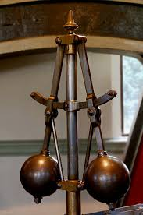
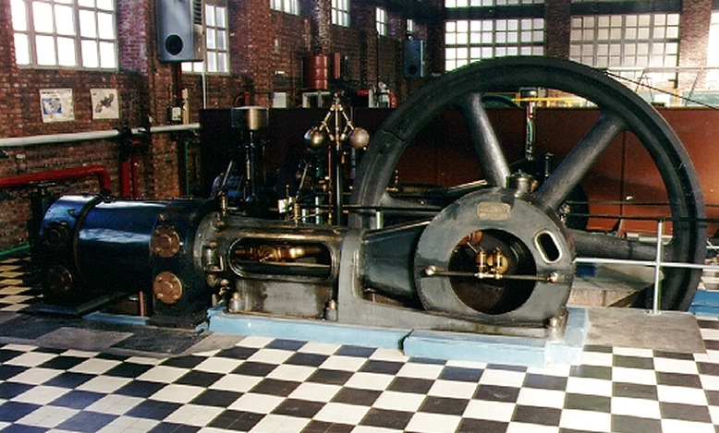
Brilliant idea no. 1 - revisited
Centrifugal governor
  Patented 1788 by James Watt

Slide 33
Method of operation for centrifugal governor
Angular velocity of governor shaft is proportional to engine rpm
Steam supply from boiler
As speed increases, flymasses rise and operate linkage
Control valve adjusts supply of steam to engine as linkage is moved by governor
Drive from engine to governor
Engine
Video: https://www.youtube.com/watch?v=OG1AiaNTT6s

Slide 34
Brilliant idea no. 1 – centrifugal governor revisited
Speed control is achieved by negative feedback loop
  Too fast – steam input is reduced.
  Too slow – steam input is increased.
Piston, flywheel and shaft
ω
+
Qin
K1/Js
_
K2
feedback (flymasses and valve)
MMME2046 Dynamics and Control
Lecture 3

Slide 35
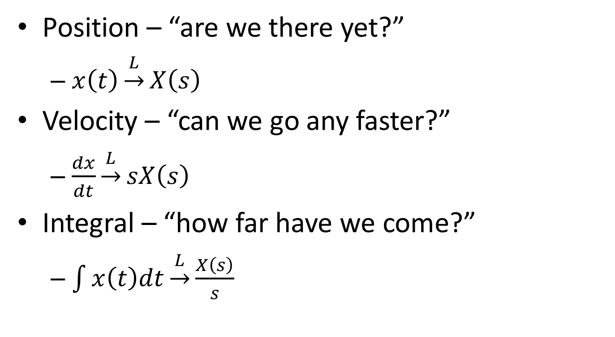
What other information can we use?
Position – “are we there yet?”
  $x\left(t\right)\underset{→}{L}X\left(s\right)$
Velocity – “can we go any faster?”
  $\frac{dx}{dt}\underset{→}{L}sX\left(s\right)$
Integral – “how far have we come?”
  $\int{x\left(t\right)dt}\underset{→}{L}\frac{X\left(s\right)}{s}$
MMME2046 Dynamics and Control
Lecture 3

Slide 36
This will be covered in the control lectures next week.
Any questions?
P.S. There is an overview/revision lecture towards the end of the course.
MMME2046 Dynamics and Control
Lecture 3

